Slide 1
PH1140 Oscillation Project
Group Beta
A Sovetkin, A. Sheikh, C. Ho
(not in order of contribution)

Slide 2
Table Of Content
Objectives
Division of Labour
Theory
The Setup
Experimental Procedure
Results and Discussion
Conclusion
Aside: Generalisation to Fractional Order Oscillators

Slide 3
Objectives
Objectives:
To investigate several harmonic oscillators including:
Simple Harmonic Oscillator
Damped Oscillator
Damped Driven Oscillators
Compare how well our theoretical models fit the experimental results
Experimentally verify theory

Slide 4
Division of Labour
Alex
Carry Out Experimental Procedure
Measurement
Araaf
Carry Out Experimental Procedure
Measurement
Conrad
Theory
Plotting
Write Up

Slide 5
Theory
Recipe:
Identity Set Up
Consider its Lagrangian
Euler-Lagrange Equation
Solve the ODEs
Theoretical Models
Let’s consider see an example for Simple Harmonic Oscillator (SHO)

Slide 6

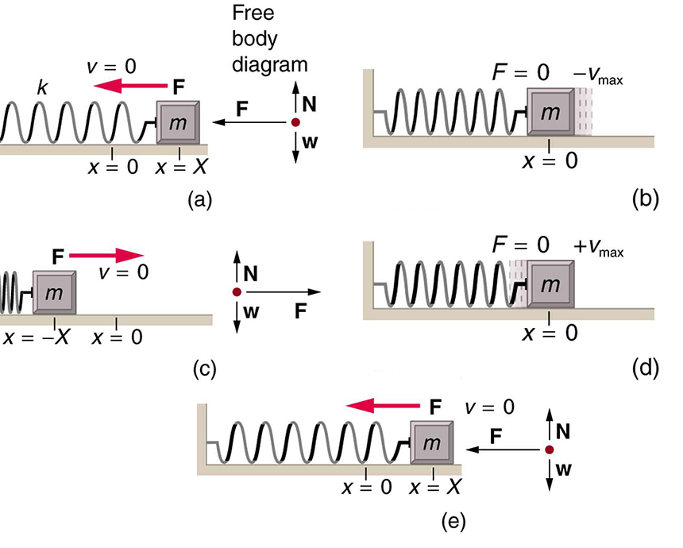
Theory: Simple Harmonic Oscillator
Set Up:
Consider a point mass attached to a spring
Mass, m (kg)
Spring Constant, k (N/m)
Move along the x-axis
https://courses.lumenlearning.com/atd-austincc-physics1/chapter/16-3-simple-harmonic-motion-a-special-periodic-motion/

Slide 7
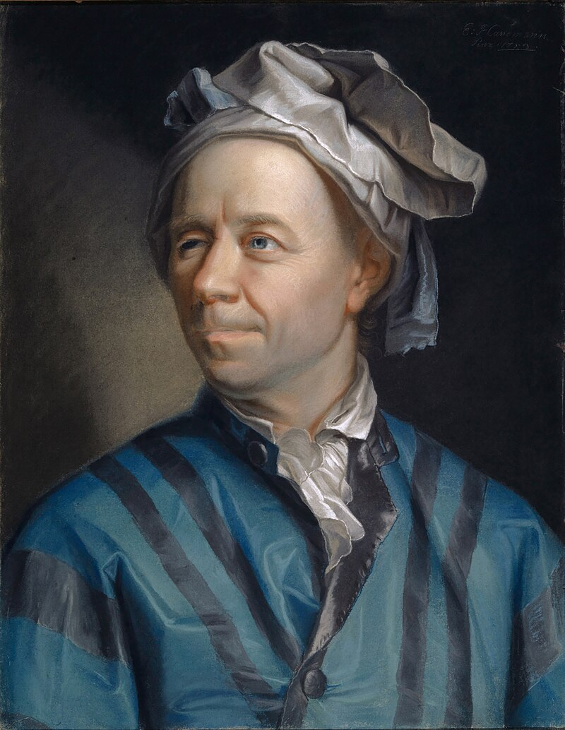
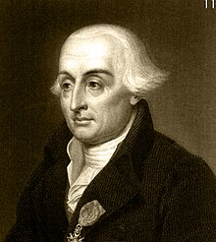

Theory: Simple Harmonic Oscillator
Fun Fact:
Lagrange was only 19 when he collaborated with Euler for this equation!
Lagrangian
$$L=T−V \\ L=\frac{1}{2}mx^{′2}−\frac{1}{2}kx^{2}$$
Euler-Lagrange Equation
$$\frac{∂L}{∂x}−\frac{d}{dt}\left(\frac{∂L}{∂x^{′}}\right)=0$$
Lagrange
(1736-1813)
Euler
(1703-1783)

Slide 8

Theory: Simple Harmonic Oscillator
Then we obtain the following expression:
$$mx^{′′}+kx=0 \\ x^{′′}=−\frac{k}{m}x$$
Since the natural frequency $ω=\sqrt{\frac{k}{m}}. Hence:$
$$x^{′′}=−ω^{2}x$$

Slide 9

Theory: Simple Harmonic Oscillator
Solve the homogenous ODE
We use the Ansatz $\text{x}\text{ = }e^{rt}$ where x, $r∈ ℂ$
Recall the ODE:
$$x^{′′}=−ω^{2}x$$
By substituting in our ansatz:
$$r^{2}+ω^{2}=0$$
Solving the characteristic polynomial as above

Slide 10

Theory: Simple Harmonic Oscillator
Characteristic Polynomial
$$r^{2}+ω^{2}=0 \\ r= ±ωi$$
By substituting into our general form of a 2nd order ODE solution:
$$x\left(t\right)=c_{0}cos\left(ωt\right)+c_{1}sin(ωt)$$
At time t = 0, x has to be the amplitude:
$$x\left(0\right)=A$$
Hence:
$$x\left(t\right)=Acos\left(ωt\right)$$
Theoretical Model

Slide 11
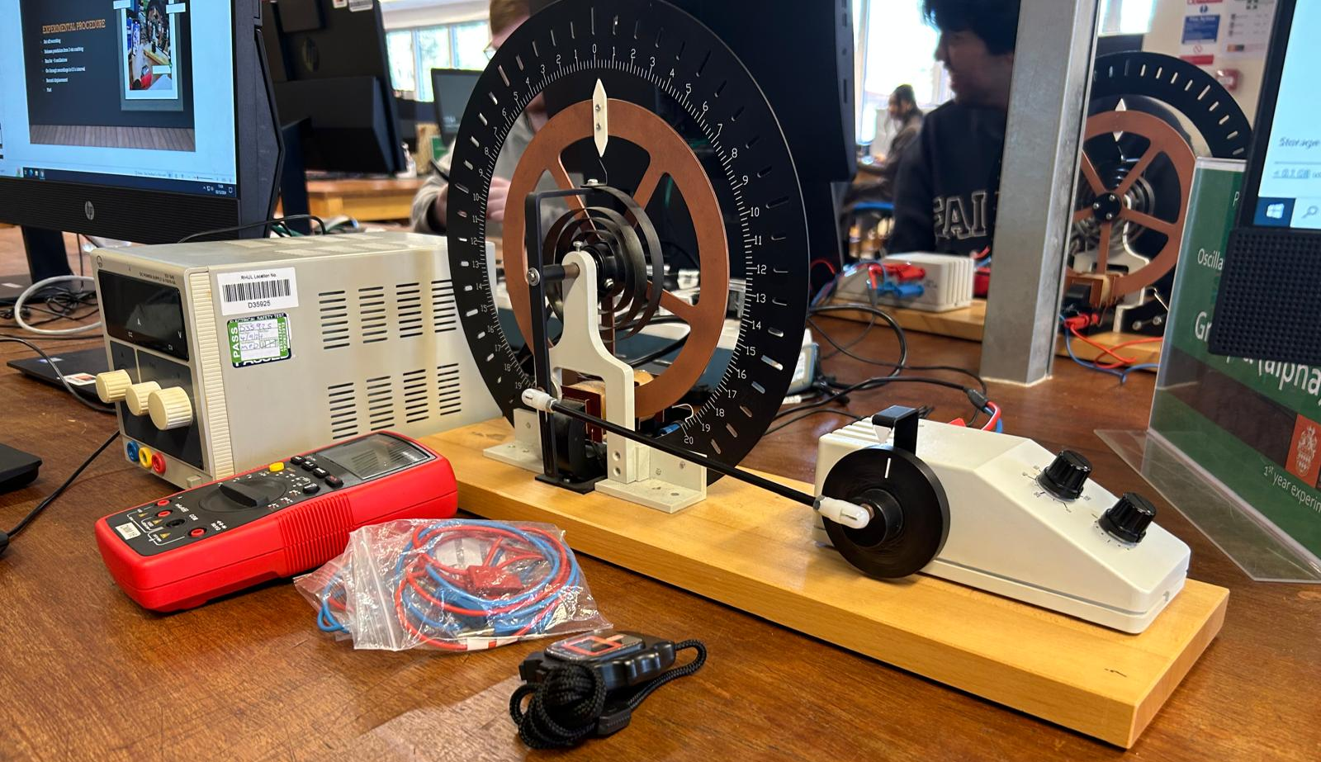
The Set-up
The bearing: Displacement (arbitrary unit)
Solenoid
Torsion Pendulum
Motor
Multimeter
Stopwatch (s)

Slide 12
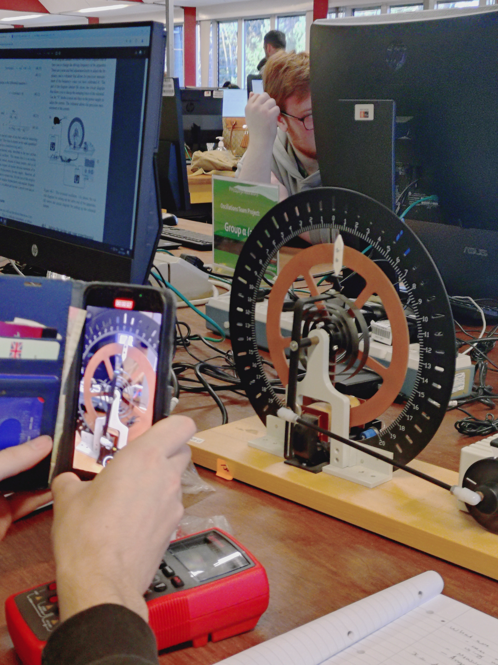
Experimental Procedure
Set off recording
Release pendulum from the marking at 3 arbitrary units:
For the DDHO:
On top of our manual release, we also used a motor to drive the oscillator
Angular frequency : 2.42 rads^-1 from a measured period of 2.60s.
Run for ~5 oscillations
To record the time of oscillations, use the iPhone software to record and slow down the footage of the oscillation to make accuracy and precision of measurements better
Go through recordings in 0.5 s interval
Record displacement for the respective time
Plot!

Slide 13
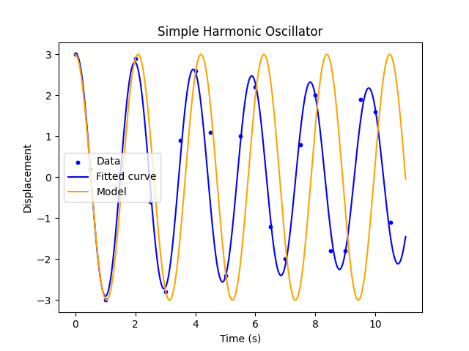
Simple Harmonic Oscillator
The theoretical model is given to be:
x(t) = Acos(ωt)
For small time, t, the model fits the theoretical-model but as time, t , we cam see that the displacement from the equilibrium is not constant, hence suggesting a dampening effect.
This occurs, as a direct consequence to the frictional force as no system is frictionless, thus explaining why some minimal damping occurs.
See the appendix A for SHO data.

Slide 14
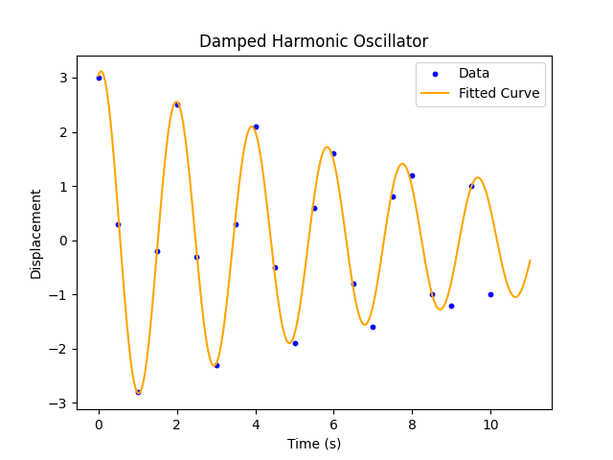
Damped Harmonic Oscillator
The theoretical model is given to be:
x(t) = Acos(ωt) exp(-γt/2)
Unlike the damping in SHO, the damping in DHO is generated due to the magnetic field in the solenoid of component B, the denser the B-field, the greater the damping force.
Outlier caused by non-uniform B-field?
The initial amplitude, A was 3 (arbitrary units)
See Appendix B for DHO data.

Slide 15
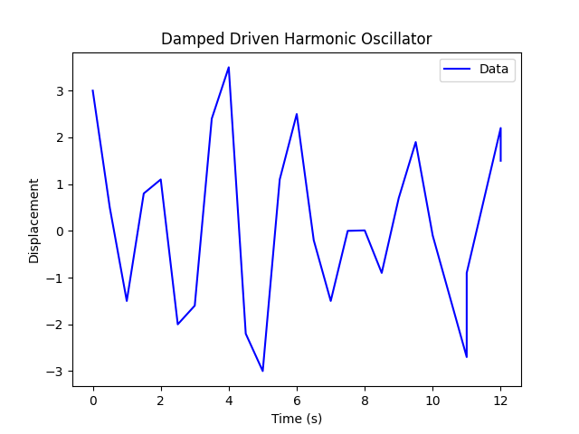
Damped Driven Harmonic Oscillator
For this system, we did not fit it against a model
x(t) = A cos(ω_{D}t+ϕ)φ
However, we can still see the amplitude changing in relatively irregular manner (decreasing and increasing) compared to previous systems
Therefore, we can confirm, there exists application of external force (i.e. the driving force from the motor.)
The time period (T) and angular frequency (ω₀):
T = 3.34 s ±0.001 s
ω₀ = 2.51 ± 0.001 rad/s (using uncertainty formula)
See Appendix C for DDHO data.

Slide 16
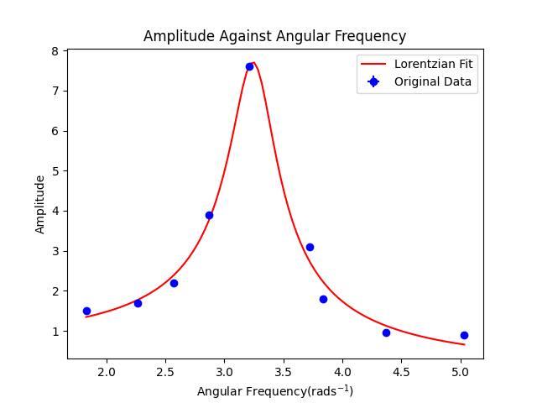
Amplitude-Angular Frequency
Identify time of 1 full period of the motor.
Use 2π/T to get angular frequency
Recorded the associated max. displacement
By increasing the setting on the motor, we obtained different value of angular frequency and displacement.
Plotting max displacement against ω, we get the resonance graph (on the right)
The result shows a Cauchy distribution
See Appendix D for x-omega data.

Slide 17
Conclusion
We discussed:
Theoretical Model
Experimental Set Up
Experimental Procedure
Results
Relevant Uncertainties and their Effects on Results
Based on experimental results, it matches and verifies our theories!

Slide 18
Aside Generalisation to Fractional Order Oscillators
Conrad Ho
(Please Feel Free to Talk to me if you find this interesting! Would be happy go into more depth!)

Slide 19

Aside: Generalisation to Fractional Order Oscillators
Replace the order of the ODEs into fractional order α
Note:
$$D_{t}^{α}↔ \frac{d^{α}}{dt^{α}}, 0<α<1 , α∈ℂ$$
For example, our SHO ODE becomes:
$$D_{t}^{2α}x\left(t\right)=−ω^{2}x$$
We solve this Fractional ODE (FODE) numerically using python library fodeint
Note: We can solve this analytically but for simplicity’s sake and convenience in plotting, we did this numerically

Slide 20
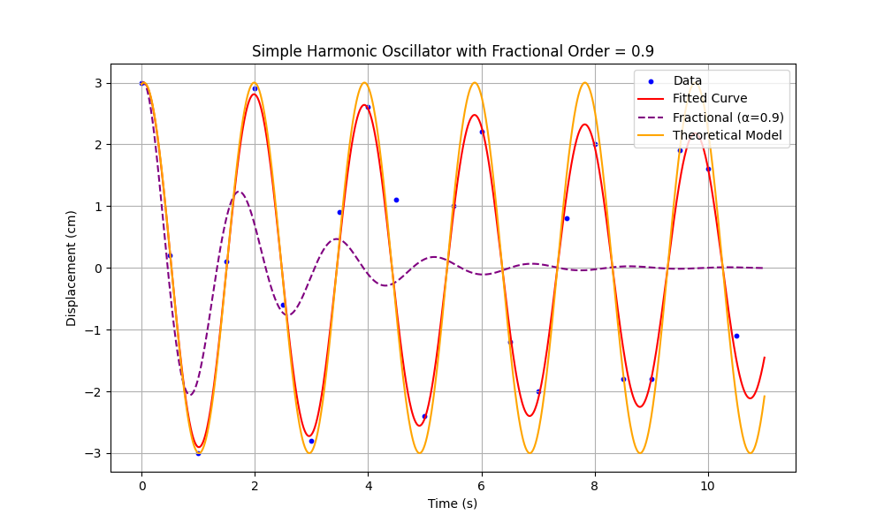
Aside: Generalisation to Fractional Order Oscillators
Result:
Plotting α = 0.9 against our data and theoretical model
As lim α -> 1, we recovers the integer order model
Not an exponential decay!
This gives rise to interesting physical investigation

Slide 21
Aside: Generalisation to Fractional Order Oscillators
Theoretical Explanation:
Integral and Differential is a continuum in fractional order
Gives rise to the differintegral operator
A non-local operator!
Associated memory effects:
Not only instantaneous
It considers its history
Hence the decay

Slide 22
Aside: Generalisation to Fractional Order Oscillators
Future Work:
Optimise α to a data set from an experiment
Investigate non-exponential decay in Oscillators
Physical implication of fractional order
Experimental realisation
Apply to Quantum Harmonic Oscillators?

Slide 23
Aside: Generalisation to Fractional Order Oscillators
Recommended Reading:
[1] Tarasov VE. Fractional dynamics: applications of fractional calculus to dynamics of particles, fields and media. Springer Science & Business Media; 2011 Jan 4.
[2] Jin B. Fractional differential equations. Cham, Switzerland: Springer International Publishing; 2021.
[3] Herrmann R. Fractional calculus: an introduction for physicists. 2011 Feb 21.
[4] Hilfer R, editor. Applications of fractional calculus in physics. World scientific; 2000 Mar 2.
[5] Diethelm K, Kiryakova V, Luchko Y, Machado JT, Tarasov VE. Trends, directions for further research, and some open problems of fractional calculus. Nonlinear Dynamics. 2022 Mar;107(4):3245-70.
[6] Tarasov VE, editor. Handbook of fractional calculus with applications. Berlin, Germany: de Gruyter; 2019.

Slide 24
Appendix

Slide 25
Appendix A: Raw Data for SHO
No | Time, t +/- 0.01 s | Displacement , x +/- 0.01 arbitrary units
1 | 0.0 | 3.0
2 | 0.5 | 3.0
3 | 1.0 | -2.8
4 | 1.5 | -0.2
5 | 2.0 | 2.5
6 | 2.5 | -0.3
7 | 3.0 | -2.3
8 | 3.5 | 0.3
9 | 4.0 | 2.1
10 | 4.5 | -0.5
11 | 5.0 | -1.9
12 | 5.5 | 0.6
13 | 6.0 | 1.6
14 | 6.5 | -0.8
15 | 7.0 | -1.6
16 | 7.5 | 0.8
17 | 8.0 | 1.2
18 | 8.5 | -1.0
19 | 9.0 | -1.2
20 | 9.5 | 1.0
21 | 10.0 | -1.0

Slide 26
Appendix B: Raw Data for dho
no | t +/- 0.01 s | x +/- 0.01 arbitrary units
1 | 0.0 | 3.0
2 | 0.5 | 0.2
3 | 1.0 | -3.0
4 | 1.5 | 0.1
5 | 2.0 | 2.9
6 | 2.5 | -0.6
7 | 3.0 | -2.8
8 | 3.5 | 0.9
9 | 4.0 | 2.6
10 | 4.5 | 1.1
11 | 5.0 | -2.4
12 | 5.5 | 1.0
13 | 6.0 | 2.2
14 | 6.5 | -1.2
15 | 7.0 | -2.0
16 | 7.5 | 0.8
17 | 8.0 | 2.0
18 | 8.5 | -1.8
19 | 9.0 | -1.8
20 | 9.5 | 1.9
21 | 10.0 | 1.6
22 | 10.5 | -1.1

Slide 27
Appendix C: Raw Data for dDho
No | Time ,t, (s ) +/- 0.01 | Displacement , x (arbitrary units ) +/- 0.01
1 | 0.0 | 3.0
2 | 0.5 | 0.5
3 | 1.0 | -1.5
4 | 1.5 | 0.8
5 | 2.0 | 1.1
6 | 2.5 | -2.0
7 | 3.0 | -1.6
8 | 3.5 | 2.4
9 | 4.0 | 3.5
10 | 4.5 | -2.2
11 | 5.0 | -3.0
12 | 5.5 | 1.1
13 | 6.0 | 2.5
14 | 6.5 | -0.2
15 | 7.0 | -1.5
16 | 7.5 | 0.0
17 | 8.0 | 0.01
18 | 8.5 | -0.9
19 | 9.0 | 0.7
20 | 9.5 | 1.9
21 | 10.0 | -0.1
22 | 10.5 | -2.7
23 | 11.0 | -0.9
24 | 11.5 | 2.2
25 | 12.0 | 1.5

Slide 28
Appendix D: Raw Data for x-Omega
Period (s) | Angular freq rad/s | Max. Displacement (arbitrary unit)
3.44 | 1.83 | 1.5
2.78 | 2.26 | 1.7
2.45 | 2.57 | 2.2
2.19 | 2.87 | 3.9
1.96 | 3.21 | 7.6
1.69 | 3.72 | 3.1
1.64 | 3.84 | 1.8
1.44 | 4.37 | 0.95
1.25 | 5.03 | 0.9

